Slide 1
Communication
Working with sockets

Slide 2
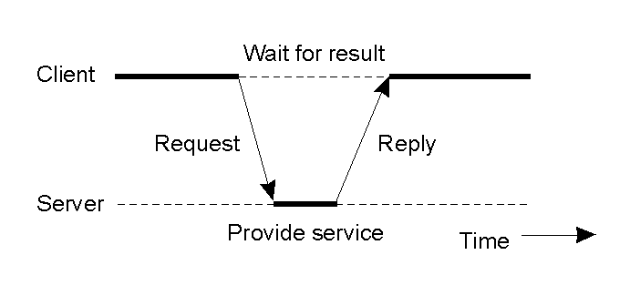
Client-Server
1.25
General interaction between a client and a server.

Slide 3
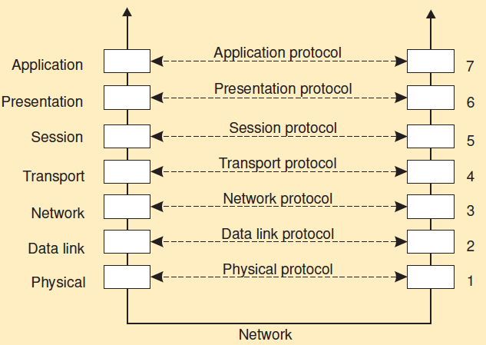
Basic networking model

Slide 4
Low-level layers
Recap
Physical layer: contains the specification and implementation of bits, and their transmission between sender and receiver
Data link layer: prescribes the transmission of a series of bits into a frame to allow for error and flow control
Network layer: describes how packets in a network of computers are to be routed. IP: Connectionless, no guarantees
Observation
For many distributed systems, the lowest-level interface is that of the network layer.

Slide 5
Transport Layer
The transport layer provides the actual communication facilities for most distributed systems.
Standard Internet protocols
TCP: connection-oriented, reliable, stream-oriented communication
UDP: unreliable (best-effort) datagram communication

Slide 6
Discussion
Consider the following scenarios
Scenario 1:
Company A wants to transfer data to Amazon Web Service (AWS) for storage.
Scenario 2:
Alice is using Zoom to talk to Bob for a video conference.
For each scenario, should TCP or UDP be used? Why?
Please go to PollEv.com/cisgvsu429

Slide 7
Introduction to Sockets (1)
What are Sockets?
End-point of inter-process communication.
An interface through which processes can send / receive information
The Client-Server model
Most inter-process communication uses client-server model
The Client process connects to the Server process,
To make a request for information/services owned by the Server.
Once the connection is established between them,
They can start sending / receiving information.

Slide 8
Introduction to Sockets (2)
What exactly creates a Socket?
<IP address, Port #> tuple
What makes a connection?
Source<IP addr, Port #>
Destination <IP addr, Port #>
Source socket + destination socket pair uniquely identifies a connection.
Most services are tied to a specific port
ftp-data 20 File Transfer [Default Data]
ftp 21 File Transfer [Control]
telnet 23 Telnet
smtp 25 Simple Mail Transfer
www 80 Web (HTTP)

Slide 9
Socket Addressing (IP Address + Port Number)
Ext-2
Ext-3
Ext-1
Extension Number (Port Number)
Company Phone Number (IP Address)
A woman contacts a salesman with Company Phone Number + Extension Number

Slide 10
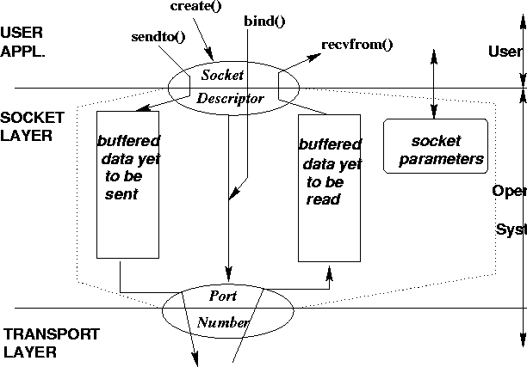
Sockets: Conceptual View
Notes:
You can think of the socket layer as another layer between application and transport layers. Or socket layer as the interface to transport layer services.

Slide 11
Connection-Oriented Application
Server gets ready to serve clients
Creates a socket
Binds an address to the socket
Server’s address should be made known to clients
Client contacts the server
Creates a socket
Connects to the server
Client has to know the address of the server
Server Accepts connection requests from clients
Blocks until connection requested or error
Further communication is specific to application

Slide 12
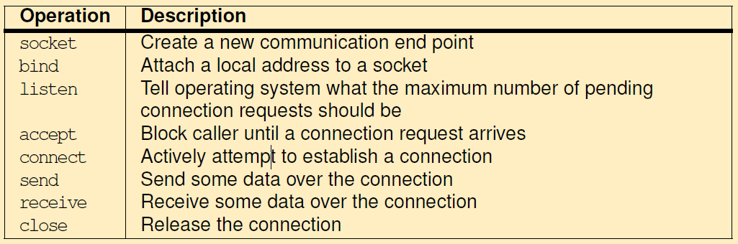
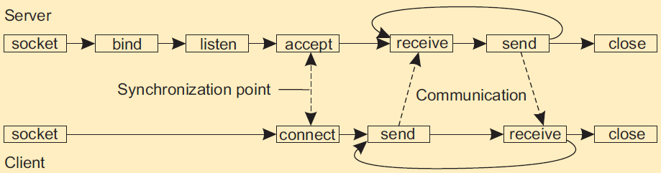
Operations and Diagram

Slide 13
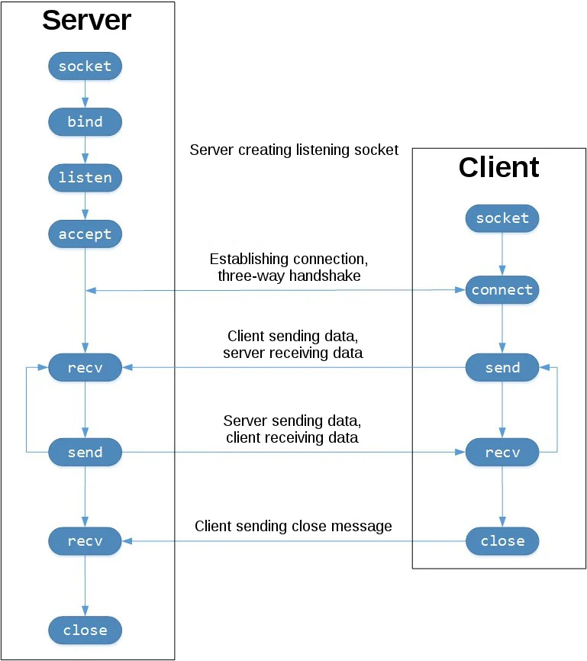
Python Socket
Server
s1 = socket.socket(…)
s1.bind((‘’, PORT)) #server’s address
s1.listen()
conn, addr = s1.accept()
use conn to communicate with the client
Client
s2 = socket.socket(…)
s2.connect((HOST, PORT)) #server’s address
use s2 to communicate with the server
conn
s2
https://realpython.com/python-sockets/

Slide 14
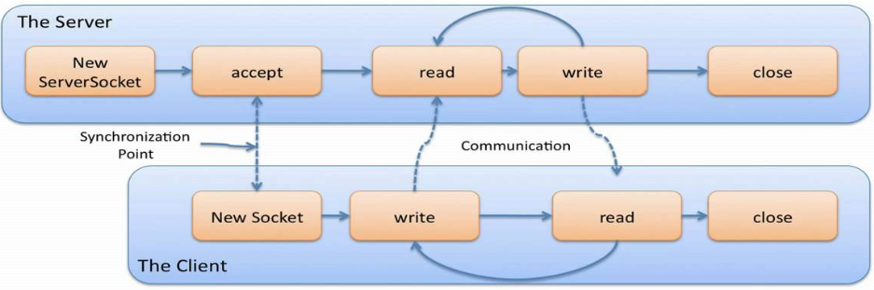
Java Socket
Server
ServerSocket listener = new ServerSocket(Port#));
Bind server’s own address with port number
Socket socket1 = listener.accept();
Listen on the ServerSocket for the client’s request
socket1 is the socket that communicates with the client
Use socket1 to communicates with the client
socket1
Client
Socket socket2 = new Socket(ServerAddress, Port#);
Create a socket using server’s address and port number
Client connects to the server if the server is listening on that port number
Use socket2 to communicate with the server
socket2.close(); Close the socket
socket2

